Slide 1

Agenda
Introduction
ShopEasy details Analysis
Customer performance in country wise
Suggestion
Project description

Slide 2

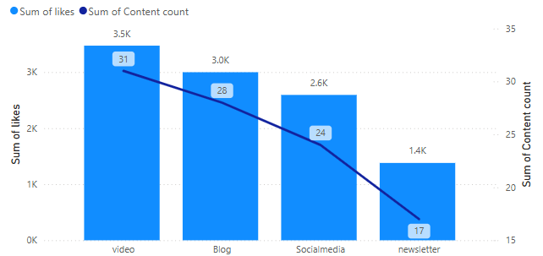
ShopEasy details Analysis
Customer Engagement
Marketing channels like blogs, social media, and video content influence customers more than newsletters.
Highly marketed product sales are high compares to low marketed products
This is supported by the fact that 63.9% of the world’s population uses social media.
Ages 18–29: YouTube (93%), Instagram (76%), Facebook (68%), Snapchat (65%)
Ages 30–49: YouTube (94%), Facebook (78%), Instagram (66%), Pinterest (43%)
ProductID | Product name
1 | Running Shoes
2 | Fitness Tracker
6 | Tennis Racket
7 | Basketball
8 | Football Helmet
12 | Ice Skates
15 | Climbing Rope
16 | Kayak
17 | Surfboard
19 | Hockey Stick
20 | Boxing Gloves

Slide 3
ShopEasy details Analysis
Customer Review Analysis
Review Behaviors
How does product review affect the customer purchasing rate?
High rated product reviews increase the sale of product
customer have less knowledge about the product, product review will definitely impact sales
Negative reviews and customer complaints
ProductID | ProductName | Price | Review
9 | Baseball Glove | 327.36 | Average and Price may be cheaper
12 | Ice Skates | 37.56 | Average and Price may be cheaper
13 | Swim Goggles | 145.97 | Average and Price may be cheaper
16 | Kayak | 259.4 | Average and Price may be cheaper
17 | Surfboard | 275.43 | Average and Price may be cheaper
18 | Volleyball | 42.8 | Average and Price may be cheaper
10 | Golf Clubs | 81.59 | Average one of the customer face issue in the product
3 | Yoga Mat | 485.32 | Good, but one of the customer face issue in the product
6 | Tennis Racket | 36.07 | Good, but one of the customer face issue in the product
14 | Cycling Helmet | 472.32 | No reviews and No purchase
4 | Dumbbells | 26.21 | Not bad, one of the customer face issue in the product
7 | Basketball | 225.12 | Price may be cheaper and instruction not clear

Slide 4
ShopEasy details Analysis
Product Performance Analysis
Product | Top Sales - 1 | Top Sales - 2
Kayak | Austria | Spain
Surfboard | Spain / Italy / Germany
Swim Goggles | Netherland | Spain
Fitness Tracker | Spain | Germany
Tennis Racket | Spain
Climbing Rope | Spain | Belgium
Ski Roots | Austria / Italy
Basket Ball | Austria
Hockey Stick | Netherland
Running shoes | Italy
Soccer Ball | UK
Volley Ball | Spain
Country
Product
POWER BI
Performance
Analysis Report of product performance

Slide 5
ShopEasy details Analysis
Drop-Off Stage
20% of customers were in Checkout stage and out of 20%, 70% customer are dropped out
54% of customer were visited the Homepage stage
26% of customers were visited the Productpage stage
Statistics
Probability of website visitor converting to a customers is 6%
Probability of drop-off is 14%
Probability of Homepage to ProductPage visitor is 60%
Probability of ProductPage to Checkout visitor is 79%

Slide 6
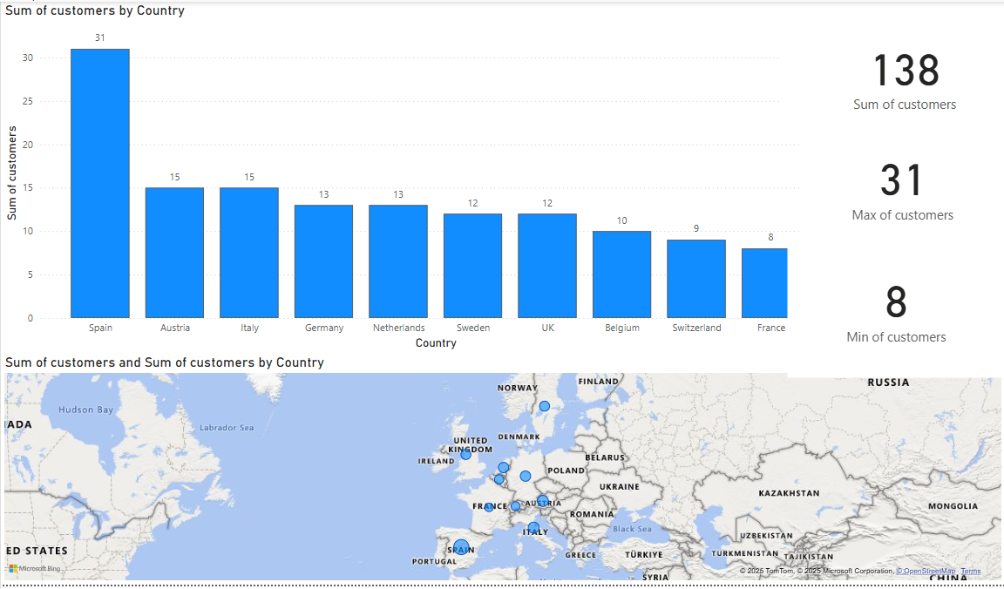
Customer performance in country wise

Slide 7




Suggestion & Improvement areas
Homepage
1.Develop a visually compelling and user-friendly homepage to enhance first
2.impressions and user engagement.Examples:
Bore homepage vs Attractive homepage
Newsletter
1.Stop investing in traditional newsletters
2.Focus on promoting under-marketed products through targeted campaigns to increase visibility and drive sales.
Marketing & offer stratgics
Step1: Offer cashback on a customer's first purchase.
Step2: Encourage the use of cashback on the second purchase.
Step3: Provide exclusive offers for every third purchase to boost customer.
Customer satisfaction
Address customer issues promptly to increase engagement and build trust
Resolving problems effectively helps capture customer attention and loyalty

Slide 8
Project desciption
Tools Used
Python (Pandas, mysql.connector)
SQL
Power BI
Excel
PowerPoint (PPT)
Data Handling & Processing
Used mysql.connector to establish a connection between Python and SQL.
Loaded CSV dataset into SQL using Python.
Utilized Pandas for data manipulation:
Created DataFrames from SQL data.
Performed joins, groupby operations, and applied conditions.
Implemented subqueries and pivot tables for deeper analysis.
Data Visualization
Used Power BI to visualize key insights from the processed data.
Created interactive dashboards for better understanding of trends and patterns.
Supporting Tools
Excel used for supplementary analysis or quick checks.
PowerPoint used to present the final findings and visualizations.

